Slide 1
MAITRI AI
AI Assistance for Astronaut
Well-Being
BY-Ramya.R.Trivedi

Slide 2
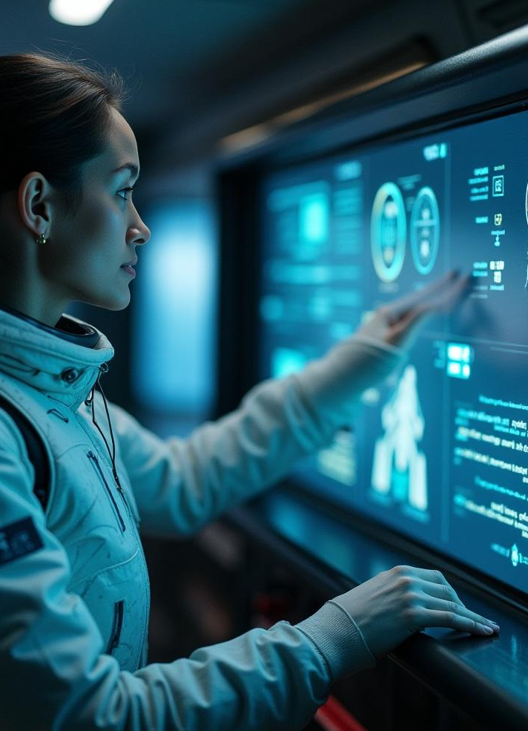
Introduction
MAITRI is an advanced AI assistant designed to support the psychological and physical health of astronauts during space missions. It combines cutting-edge technologies to monitor, analyze, and provide real-time assistance, ensuring astronauts maintain optimal well-being in challenging environments.

Slide 3
01
AI Assistance for Astronaut Well-Being

Slide 4
Psychological Support Technologies
MAITRI utilizes AI-driven tools to monitor astronauts emotional states and stress levels continuously. It offers personalized coping strategies, mental health resources, and real-time communication support to enhance psychological resilience throughout missions in isolated and confined spaces.

Slide 5
Physical Health Monitoring Systems
The system tracks vital signs such as heart rate, sleep quality, and physical activity. It provides health alerts, recommendations, and adaptive exercise plans tailored to the unique conditions of space, promoting physical fitness and early detection of potential health issues.

Slide 6
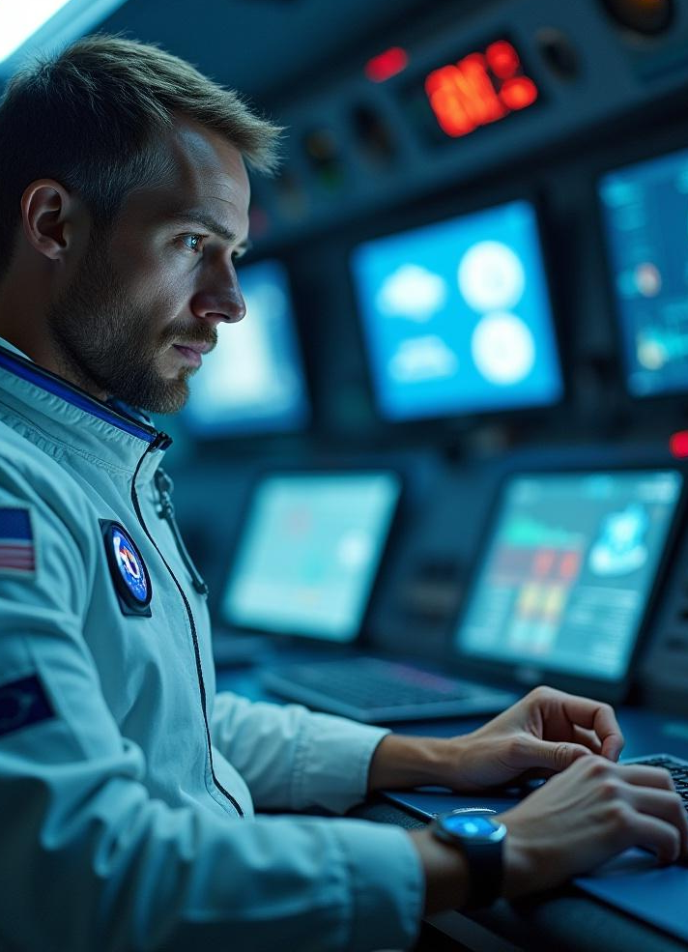
Integration in Space Missions
MAITRI is seamlessly integrated into space mission operations to provide continuous support. It interfaces with existing spacecraft systems, enabling real-time data exchange and responsive interventions. This integration ensures that astronauts receive timely health updates and personalized assistance, enhancing overall mission safety and effectiveness.

Slide 7
02
MAITRI: Features and Impact

Slide 8
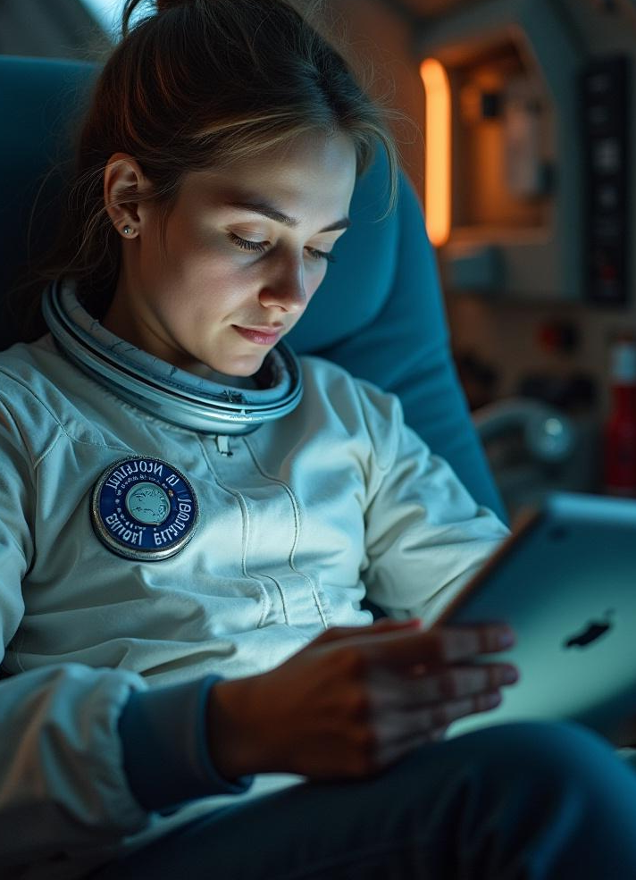
AI Capabilities for Mental Health
MAITRI employs sophisticated algorithms to detect signs of psychological distress early. It offers tailored mental health exercises, mindfulness techniques, and provides a confidential support system. These capabilities help maintain emotional stability and reduce the risk of cognitive decline during long-duration missions.

Slide 9
Physical Well-Being Applications
The AI assistant supports physical health by monitoring exercise routines, nutrition, and sleep patterns. It adjusts recommendations based on individual needs and mission requirements, ensuring astronauts maintain physical readiness and avoid health complications associated with microgravity.

Slide 10
Benefits and Challenges in Space Environment
MAITRI enhances astronaut health management through automation and personalized care. However, challenges include ensuring data privacy, managing AI limitations in unpredictable scenarios, and maintaining system reliability in harsh space conditions. Continuous updates and testing address these concerns.

Slide 11

Conclusions
MAITRI represents a significant advancement in astronaut health support by integrating AI-driven psychological and physical well-being management. Its implementation promises improved mission success and astronaut safety. Ongoing development and rigorous validation are essential to fully realize its benefits in future space exploration.

Slide 12
THANKS!
Do you have any questions?
trivediramya8@gmail.com
+91 9016515311
Please keep this slide for attribution

